Slide 2
INTRODUCTION
CPM
PUBLISHER
BIDDER CODE
BIDS COUNT
MEDIA TYPE
REVENUE
DEVICE
IMPRESSION
REQUEST
HOST
RENDERED SIZE

Slide 3
STATISTICAL AND SOFTWARE TOOLS WHICH WE HAVE USED
EXCEL
Data Visualization
R- Software
Installed packages:-randomForest,car, caret,ggplot2,dplyr
Tableau
Visualization
Chi-squared Test
Multiple Linear Regression
Random forest Regression
Decision Tree
Support Vector Regression

Slide 4

OBJECTIVE
How we increase advertisement Revenue ?
To study the relation between response and others variables.
Which factors are mostly responsible to increase revenue.
To study, to fight competition in the market and to increase the sales (by observing revenue).
To study different machine learning techniques such as Random Forest, Decision Tree, Multiple Linear Regression, support vector regression.
Choose best models from these various machine learning techniques..

Slide 5
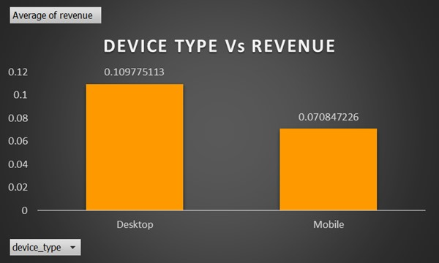
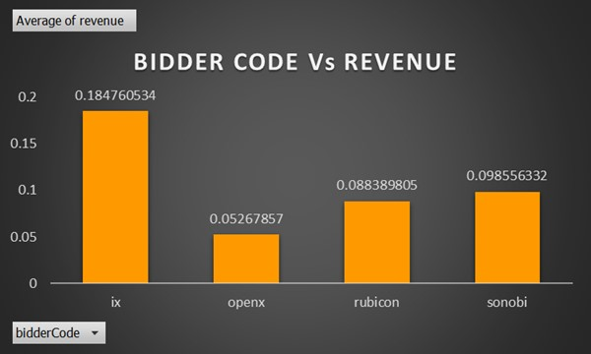
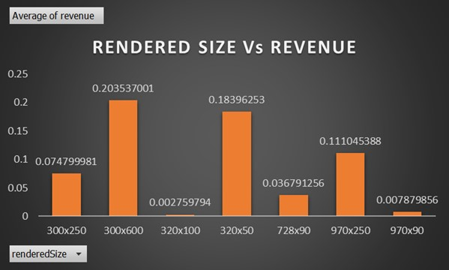
DATA VISUALIZATION

Slide 6
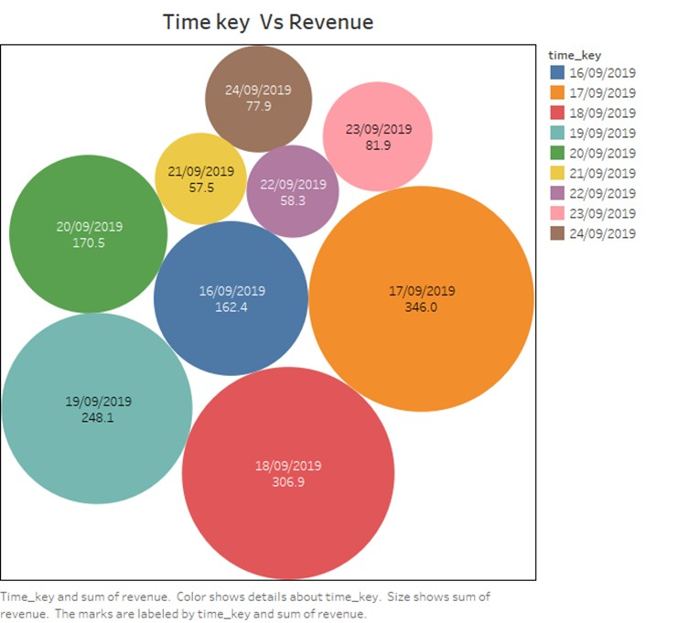
TIME KEY Vs REVENUE

Slide 7
CHI-SQUARED TEST TABLE
Variable 1 | Variable 2 | X-squared valued | P-value | Decision Rule | Conclusion
Bidder Code | Device Type | 282.44 | 2.2e-16 | P-value<0.05,Reject H0 | Dependent
 | Rendered size | 1646.5 | 2.2e-16 | P-value<0.05,Reject H0 | Dependent
Device Type | Rendered size | 3127.1 | 2.2e-16 | P-value<0.05,Reject H0 | Dependent

Slide 8
CORRELATION BETWEEN CONTINUOUS VARIABLE
 | Request | Impression | Bids count | cpm | revenue
Request | 1.0000 | 0.704978 | 0.93591 | 0.01058 | 0.66594747
Impression | 0.704978 | 1.00000 | 0.7853 | 0.00414 | 0.92718888
Bids count | 0.935913 | 0.78533406 | 1.0000 | 0.07474 | 0.80280169
Cpm | 0.010587 | -0.00414863 | 0.074744 | 1.0000000 | 0.09426785
revenue | 0.665947 | 0.92718888 | 0.828169 | 0.094268 | 1.0000000

Slide 9
MULTIPLE REGRESSION
Residual standard error: 0.1053 on 12334 degrees of freedom
Multiple R-squared: 0.8704, Adjusted R-squared: 0.8703
F-statistic: 5477 on 38 and 20961 DF, p-value: < 2.2e-16
MSE = 0.0692027
Interpretation:
From multiple regression we can conclude that There is significant relationship between revenue and Request, bids_count, cpm, biddercode, rendersize
By predicting test data we get MSE=(cal-predi)^2=0.008914
Here R-squared=0.8703
It means that 87.03% of variation in revenue is explained by its relationship with linear combination of all independent variable.

Slide 10
RANDOM FOREST
From Random Forest we get MSE = 0.005223
we can use random forest model for further predictions.
After fitting model we get list of highly important and less important variables.
IncNodePurity
152.875407
ImpressionRequest 465.572074
bids_count 296.026736
cpm 66.832335
bidderCode 19.941530
device_type 6.410859
renderedSize 29.357386
Here we found out that variable Impression is most important variable to predict revenue, whereas variable device type is less important for predicting revenue.

Slide 11
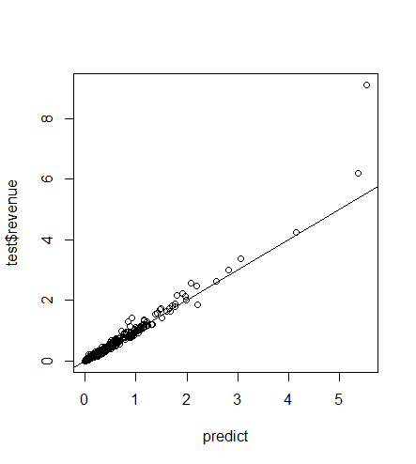
Therefore we can delete that less important variable.
After deleting less important variable we get less MSE i.e 0.004806
according to the previous MSE i.e 0.005223.
Many points are along the straight line since our random forest model is good fit for the data.

Slide 12
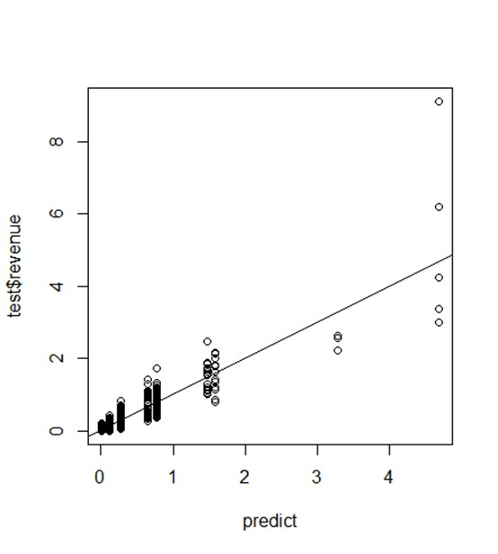
DECISION TREE
From above plot we can say that many points are of some distance from
Straight line since this model is not much good fit for the data.
And here MSE =0.01563719 & RMSE= 0.1250488 is somewhat larger than other model
Since this model is not much good .

Slide 13
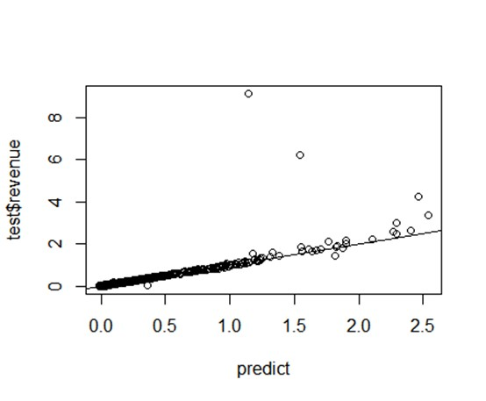
SUPPORT VECTOR REGRESSION
Here MSE of given model is 0.0295, which is somewhat larger than other model hence our
model is not much good fit for data.
Many points are along the straight line since support vector is good model.

Slide 14
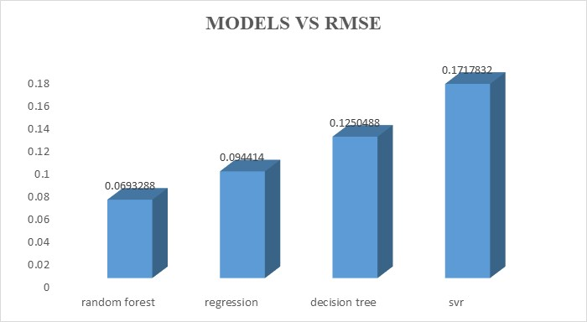
COMPARISON WITH EXISTING MODEL
Techniques | RMSE
Random forest | 0.0693288
Regression | 0.094414
Decision Tree | 0.1250488
SVR | 0.1717832
Here RMSE of SVR model is high i.e 0.1717832 & RMSE of Random forest model is comparatively less i.e 0.0693288 since our random forest model is more accurate than the other models Decision tree, SVR and Multiple Regression.
Random forest model gives most accurate result than other models.

Slide 15
OVERALL CONCLUSION
From Data visualization:
From barplot of Device type Vs Revenue, we conclude that from Desktop advertisement profit is more than advertisement publish on Mobiles.
From barplot of Bidder code Vs Revenue, ix bidder code contribute more to gain more profit. Using ix code more advertisements were open so it contribute more.
From all 7 rendered size, 300×600 size of advertisement people should be more preferable since this rendered size contribute more to gain profit.
From graph of time key Vs Revenue, on day 17/09/2019 revenue is high i.e. 346.0. People have seen more advertisement on this day company gain more profit on this day. On 21/09/2019 people have seen less advertisement so company gain less revenue (profit).
From Model Fitting:
By comparing all existing model and from that, we say that random forest model give more accurate result.
From random forest model, we can say that impression is most important variable from all variables i.e. people have seen advertisement is give more profit than other variables, since impression is most effectible factor to increase revenue (profit).

Slide 16
LIMITATIONS
The study should be only for sample size 15437.
Times of India is only publisher for the advertisement.
Banner is only media type for publishing advertisement.
Our study is limited for 9 days only.
FUTURE SCOPE
In our analysis, we came to decision that impression and bids count are two main
important factor. So to refer this result many companies and agencies will be trying to
increase profit by focusing on those 2 factor i.e. impression and bids count. So there main
aim is how they will work hard for to increase impression and bids count.

Slide 17


